Slide 1
Theory of Automata (CSC- 402) Semester : Spring 2026 Credit Hours: 3

Slide 2
Course Objective
To have a clear understanding of automata theory concepts.
To understand that regular and context free languages are useful models for many important kinds of hardware and software.
To be able to understand the use of regular and context free languages in solving problems such as lexical analysis, text processing etc.

Slide 3
Theory of Automata Course
Lecture 2

Slide 4
CHAPTER 2 - Languages
Overview

Slide 5
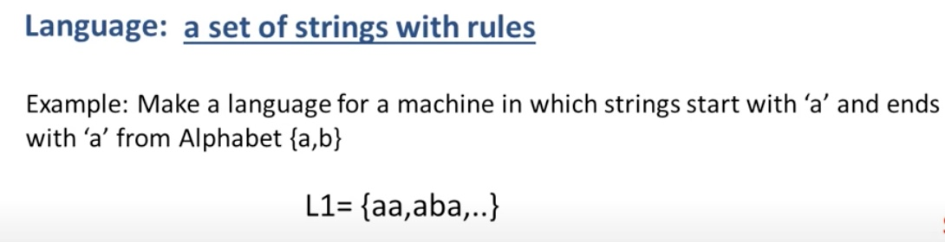
Language

Slide 6
Language
Example: The language EQUAL, of strings with number of a’s equal to number of b’s, defined over Σ={a,b}, can be written as
{Λ ,ab,aabb,abab,baba,abba,…}
Example: The language EVEN-EVEN, of strings with even number of a’s and even number of b’s, defined over Σ={a,b}, can be written as
{Λ, aa, bb, aaaa,aabb,abab, abba, baab, baba, bbaa, bbbb,…}

Slide 7
Language
Example: The language {a^{n}b^{n} }, of strings defined over Σ={a,b}, as
{a^{n} b^{n} : n=1,2,3,…}, can be written as
{ab, aabb, aaabbb,aaaabbbb,…}
Example: The language {a^{n}b^{n}a^{n} }, of strings defined over Σ={a,b}, as
{a^{n} b^{n} a^{n}: n=1,2,3,…}, can be written as
{aba, aabbaa, aaabbbaaa,aaaabbbbaaaa,…}

Slide 8
language
Example: The language factorial, of strings defined over Σ={1,2,3,4,5,6,7,8,9} i.e.
{1,2,6,24,120,…}
Example: The language FACTORIAL, of strings defined over Σ={a}, as
{a^{n!} : n=1,2,3,…}, can be written as
{a,aa,aaaaaa,…}. It is to be noted that the language FACTORIAL can be defined over any single letter alphabet.

Slide 9
task
Let S={a, bb, bab, abaab} be a set of strings. Are abbabaabab and baabbbabbaabb in S*? Does any word in S* have odd number of b’s?

Slide 10
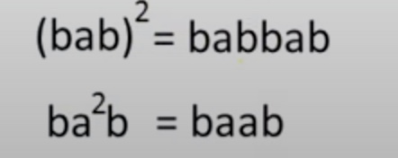
Power of String
It determines the lenth of the string

Slide 11
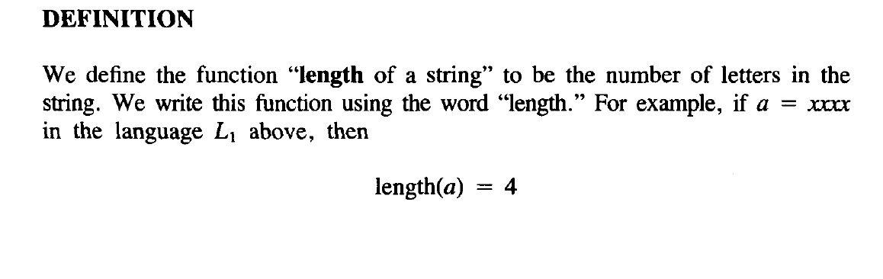
Length of a String

Slide 12
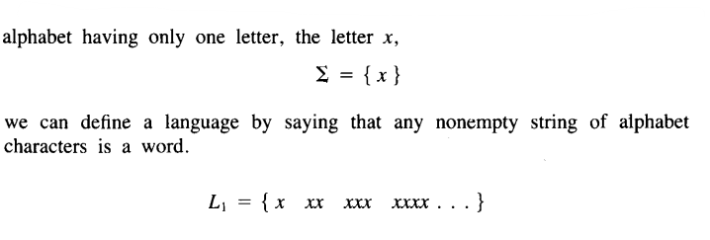
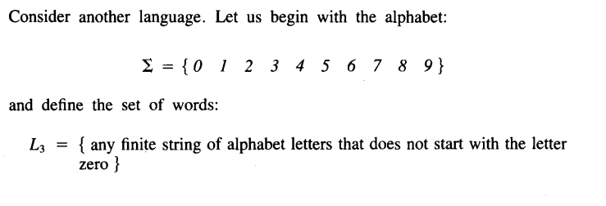
Cont...

Slide 13
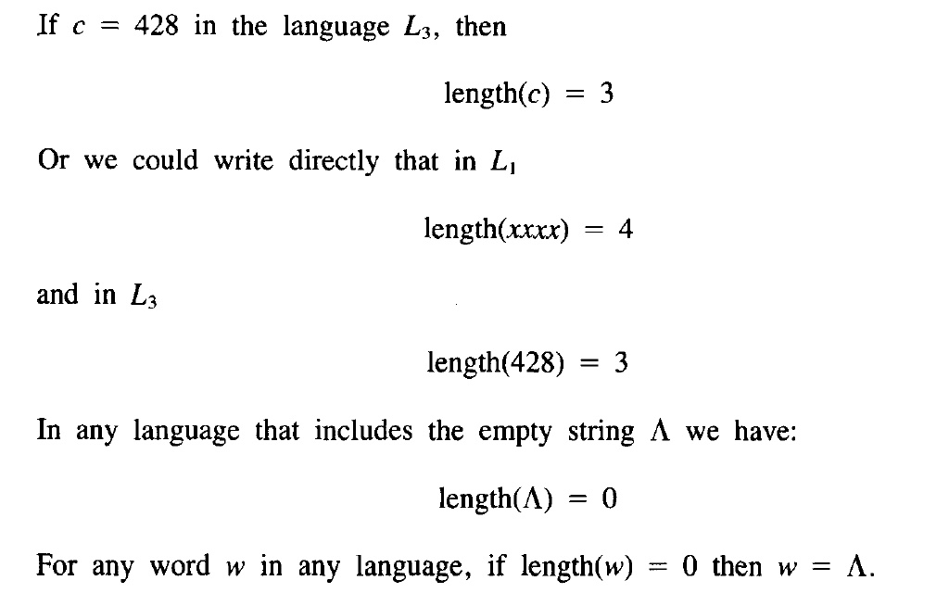
Cont...

Slide 14
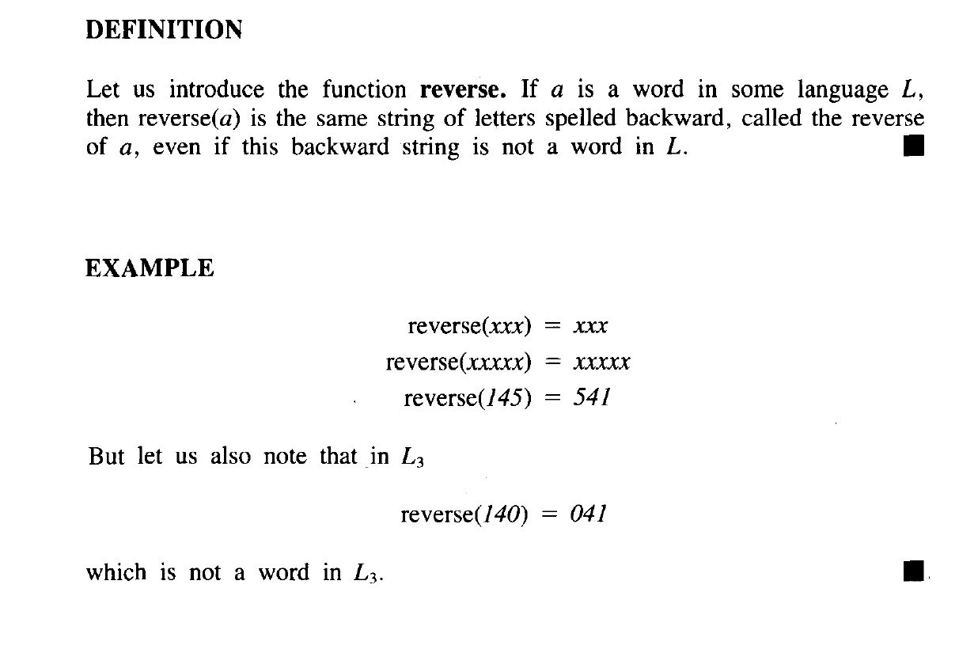
Reverse of a String- Example

Slide 15
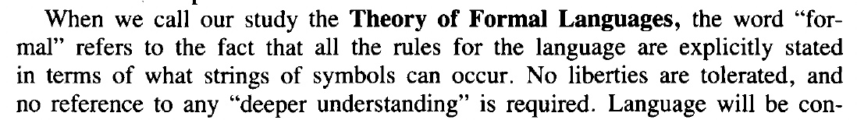
Theory of Formal Languages

Slide 16
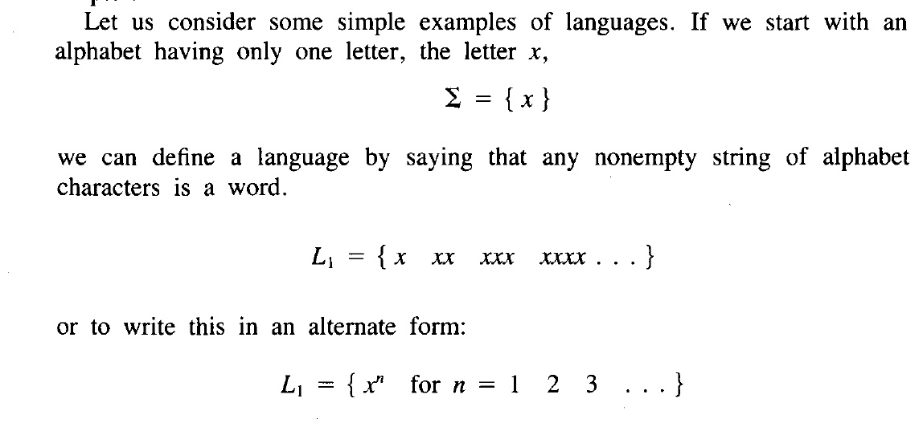
Cont...

Slide 17
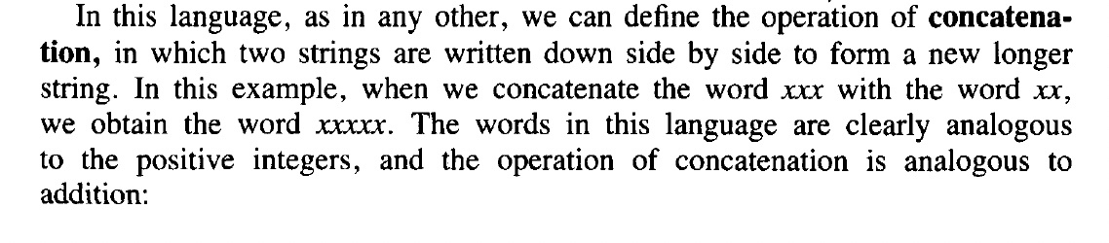

Concatenation

Slide 18
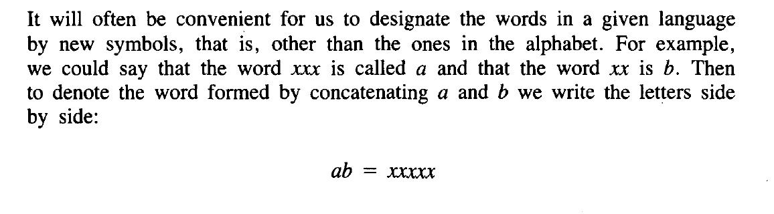
Cont...

Slide 19
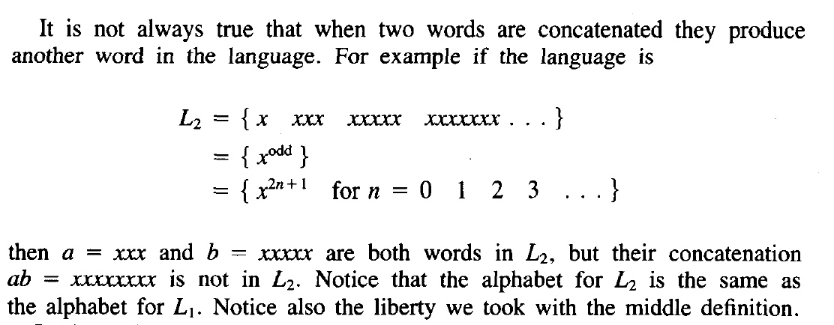
Cont...

Slide 20
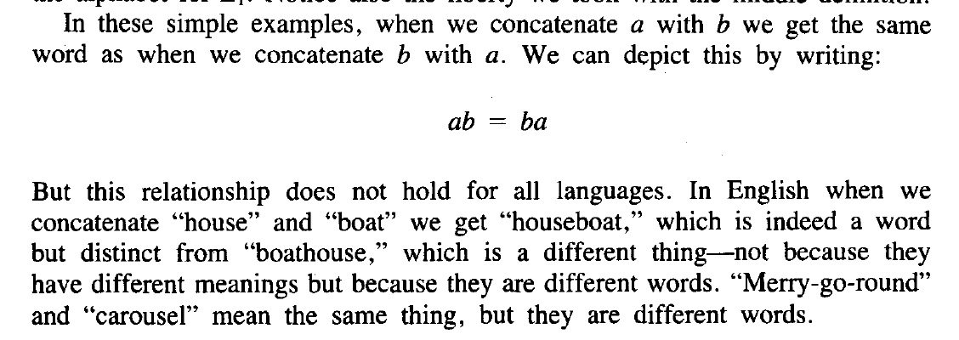
Cont...

Slide 21
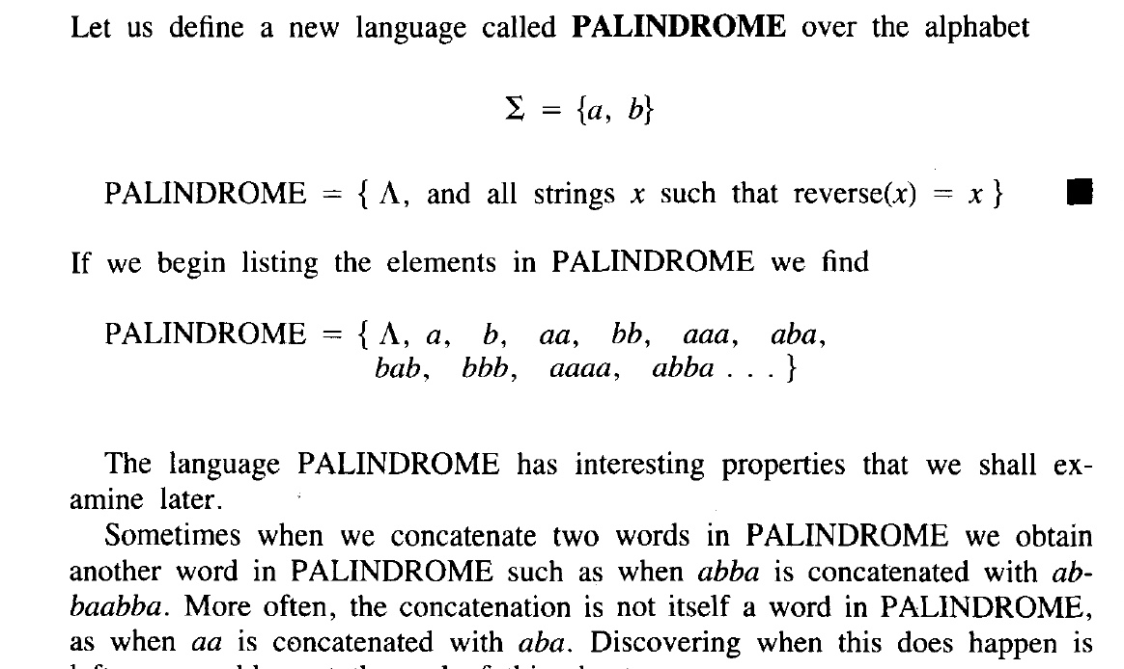
Palindrome

Slide 22
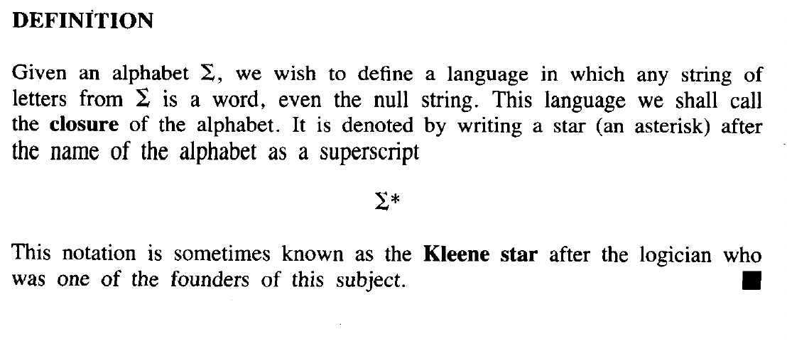
Kleene Star

Slide 23
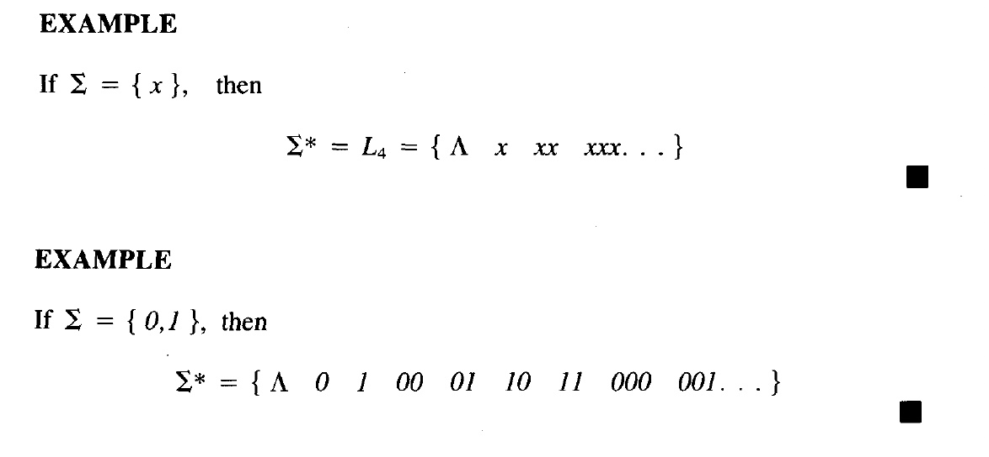
Kleene Star - Example

Slide 24
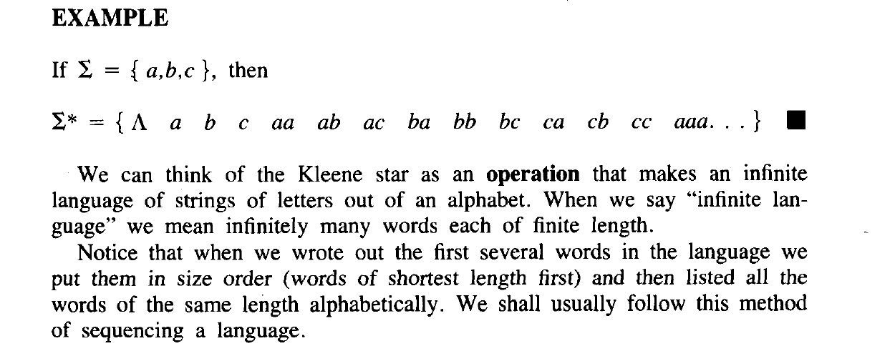
Cont...

Slide 26
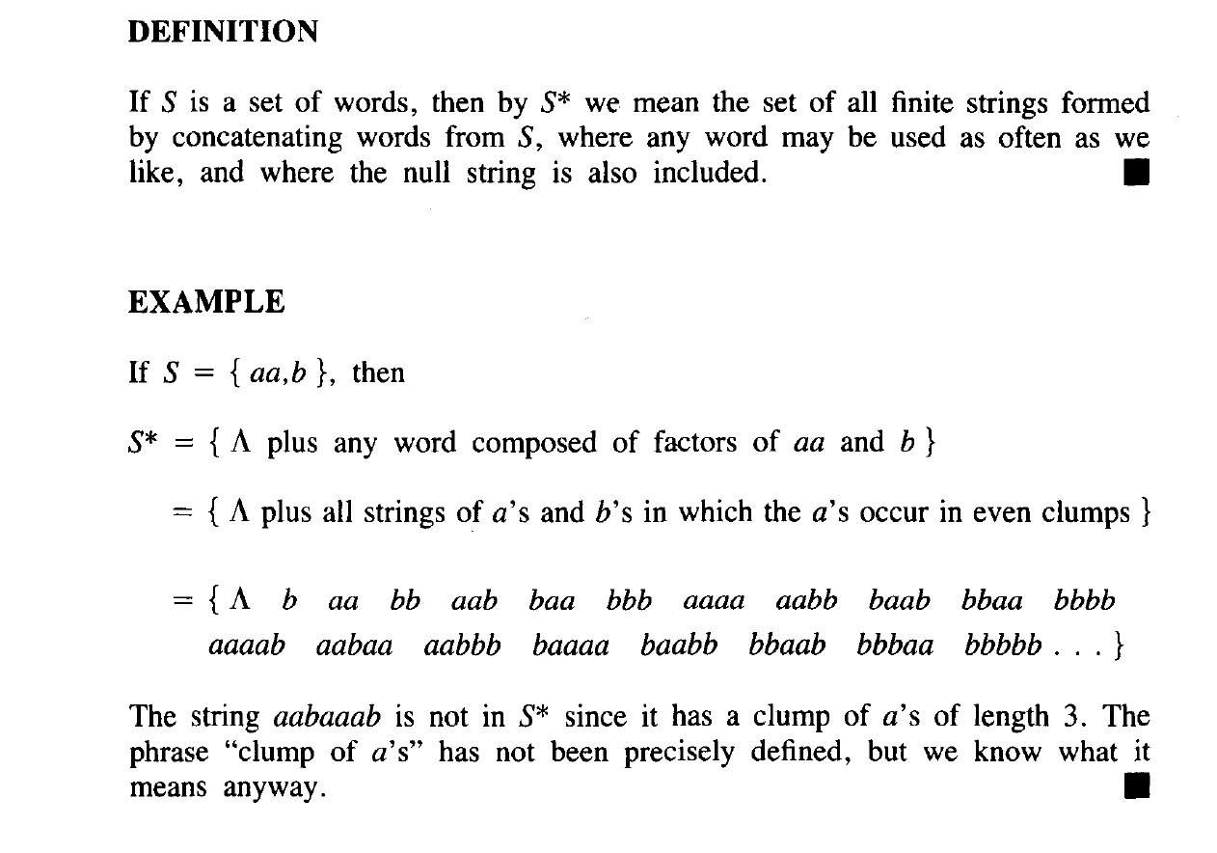
Cont...

Slide 27
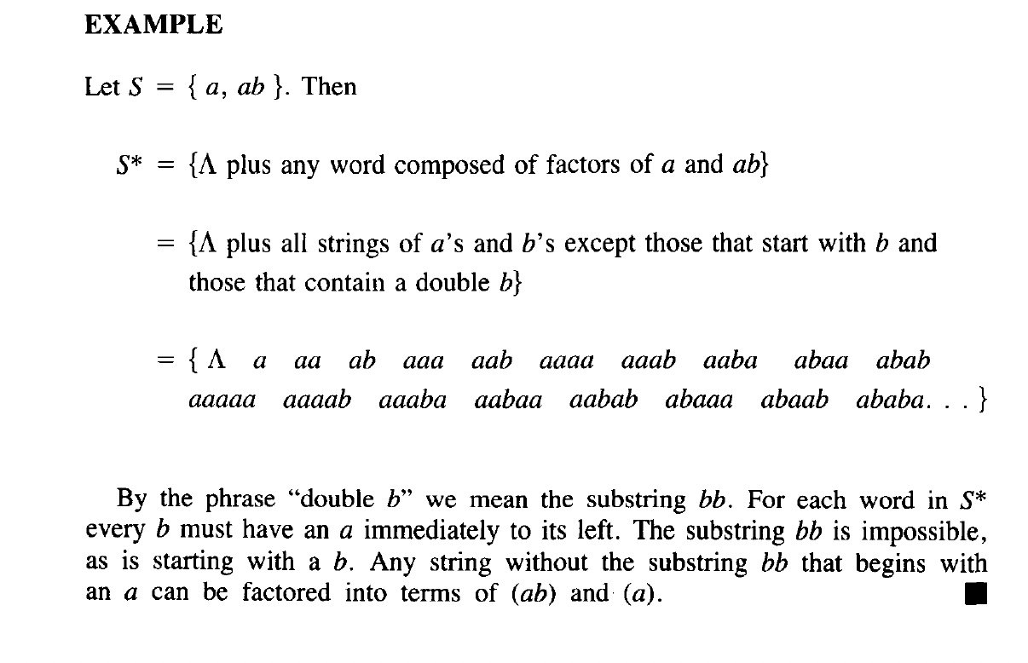
Example 2

Slide 28
PLUS Operation (⁺)
Plus Operation is same as Kleene Star Closure except that it does not generate Λ (null string), automatically.
Example:
If Σ = {0,1}
Then Σ⁺ = {0, 1, 00, 01, 10, 11, ….}
If Σ = {aab, c}
Then Σ⁺ = {aab, c, aabaab, aabc, caab, cc, ….}

Slide 29
TASK
Q1)Is there any case when S⁺ contains Λ? If yes then justify your answer.
Q2) Prove that for any set of strings S
(S⁺)*=(S*)*
(S⁺)⁺=S⁺
Is (S*)⁺=(S⁺)*

Slide 30
Remark
It is to be noted that Kleene Star can also be operated on any string i.e. a* can be considered to be all possible strings defined over {a}, which shows that a* generates
Λ, a, aa, aaa, …
It may also be noted that a⁺ can be considered to be all possible non empty strings defined over {a}, which shows that a⁺ generates
a, aa, aaa, aaaa, …

Slide 31
End of Lecture

